Slide 1

Project Goals
Average insurance cost
Male average insurance cost
Female average insurance cost
Is there any difference in average insurance cost between region?
Difference in insurance cost between smoker and non smoker
Num of female and male correspondent
Age distribution

Slide 2
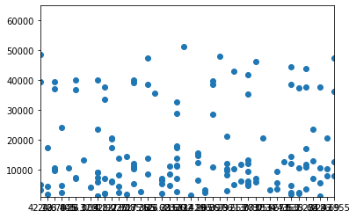
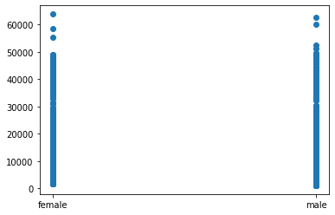
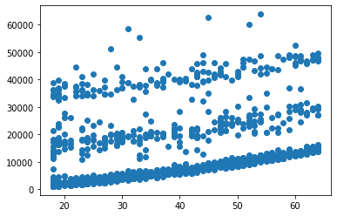
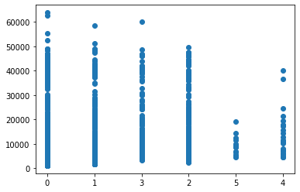
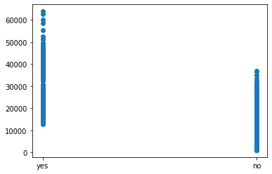
Hypothesis
Finding correlation between parameters to insurance charges
No correlation
No correlation
Insurance charge correlate to age
Insurance charges decrease as correspondents has more children
Insurance charges correlate to smoker status

Slide 3
Proof

